Slide 1

School of
Engineering and Computer Science
Te Kura Mātai Pūkaha, Pūrorohiko
Threat Modelling and Risk Assessment II CYBR 271 T2 2020
Ian Welch, Harith Al-Sahaf
Slides based upon number of sources: Threat Modelling and Risk Assessment (Chloe Ashford, security consultant, quantum security)

Slide 2
After the last lecture you should be able to …
Define asset, vulnerability, threat, security controls, risk.
Explain the benefits of threat modelling for secure system development.
Explain when threat modelling should be applied.
Outline the basic steps in threat modelling.
Explain the role of system analysis and system models in threat analysis.
CYBR 271: Secure Programming
Slide

Slide 3
Brainstorming
Experienced experts in a room.
Whiteboard, papers ….
Quality bounded by experience of brainstormers and amount of time spent brainstorming.
Three techniques:
Persona non grata
Use cases
Security cards
Notes:
Use diagrams to model the application once you understand it.

Slide 4
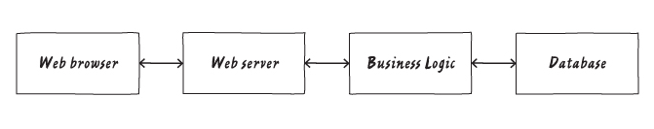
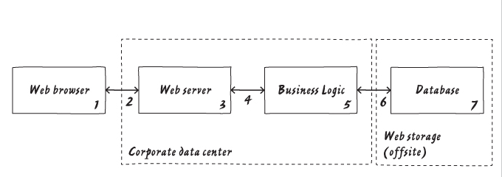
Brainstorming
Get people in a room with a whiteboard.
Draw a diagram of your system using your favourite technique, e.g for a web application
Helps to add trust boundaries to show who controls what and identify the attack surface.
Number parts of the diagram so it is easier to refer to the same part in discussions, e.g. boxes and data flows.
Notes:
ICD -

Slide 5
Brainstorming
Now consider what can go wrong with security.
eg. For the system below:
What is the web browser is being used by the person you expect?
What happens if someone modifies data in the database?
Is it OK for data to move from one box to another without being encrypted?
Notes:
Some people will actually start thinking about what goes wrong right here. For example, how do you know that the web browser is being used by the person you expect? What happens if someone modifies data in the database? Is it OK for information to move from one box to the next without being encrypted? You might want to take a minute to think about some things that could go wrong here because these sorts of questions may lead you to ask “is that allowed?”

Slide 6
Brainstorming - features
1. Requires experienced security people to come up with relevant threats.
2. Inconsistent results when repeated due to influence of prior experience.
3. Hard to communicate the results to the customer or users.
4. Doesn’t identify mitigations.
5. Hard to assess relative risk of threats.
6. How do you know when to stop?
What if we instead built the system around our users (good and bad) as well as what they want to achieve using the system?
Extension of concept of a use case developed by Ivar Jacobson (1986) to capure functional requirements, especially in software development.
Notes:
https://www.visual-paradigm.com/guide/uml-unified-modeling-language/what-is-use-case-diagram/#:~:text=In%201986%2C%20Ivar%20Jacobson%20first,requirements%2C%20especially%20in%20software%20development.
In 1986, Ivar Jacobson first formulated textual and visual modeling techniques for specifying use cases.
In 1992 his co-authored book Object-Oriented Software Engineering - A Use Case Driven Approach helped to popularize the technique for capturing functional requirements, especially in software development.

Slide 7
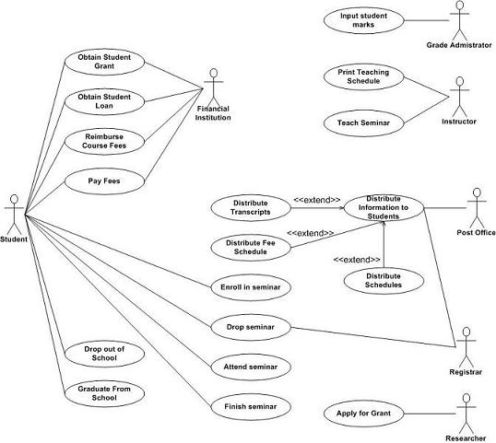
Use cases
Use case – sequence of actions providing value to an actor (horizontal ellipse).
Actors – an actor is a person, organization or external system that plays a role in one or more interactions. Usually a stick figure.
Associations – between actors and use cases reprMesented by solid lines. Optional arrowhead indicates direction of the initial invocation.
Roles – in << and >> marks – extend, include
Unified Modelling Language (UML) use cases
Notes:
Use cases. A use case describes a sequence of actions that provide something of measurable value to an actor and is drawn as a horizontal ellipse.
Actors. An actor is a person, organization, or external system that plays a role in one or more interactions with your system. Actors are drawn as stick figures.
Associations. Associations between actors and use cases are indicated in use case diagrams by solid lines. An association exists whenever an actor is involved with an interaction described by a use case. Associations are modeled as lines connecting use cases and actors to one another, with an optional arrowhead on one end of the line. The arrowhead is often used to indicating the direction of the initial invocation of the relationship or to indicate the primary actor within the use case. The arrowheads are typically confused with data flow and as a result I avoid their use.
In the example depicted in Figure 1 students are enrolling in courses with the potential help of registrars. Professors input the marks students earn on assignments and registrars authorize the distribution of transcripts (report cards) to students. Note how for some use cases there is more than one actor involved. Moreover, note how some associations have arrowheads¾any given use case association will have a zero or one arrowhead.
http://www.agilemodeling.com/artifacts/useCaseDiagram.htm

Slide 8
Use cases
Use case might be turned into a longer natural language description.
Example:
Use case: Pay Fees
Actors: Student, Financial Institution
Steps:
Student opens pay fees page.
Student enters credit card details.
Financial institution processes payment.
Notes:
Use cases. A use case describes a sequence of actions that provide something of measurable value to an actor and is drawn as a horizontal ellipse.
Actors. An actor is a person, organization, or external system that plays a role in one or more interactions with your system. Actors are drawn as stick figures.
Associations. Associations between actors and use cases are indicated in use case diagrams by solid lines. An association exists whenever an actor is involved with an interaction described by a use case. Associations are modeled as lines connecting use cases and actors to one another, with an optional arrowhead on one end of the line. The arrowhead is often used to indicating the direction of the initial invocation of the relationship or to indicate the primary actor within the use case. The arrowheads are typically confused with data flow and as a result I avoid their use.
In the example depicted in Figure 1 students are enrolling in courses with the potential help of registrars. Professors input the marks students earn on assignments and registrars authorize the distribution of transcripts (report cards) to students. Note how for some use cases there is more than one actor involved. Moreover, note how some associations have arrowheads¾any given use case association will have a zero or one arrowhead.
http://www.agilemodeling.com/artifacts/useCaseDiagram.htm

Slide 9

Misuse case滥用的情况
A misuse case is the evil twin of a use case.
“special kind of use case, describing behavior that the system/entity owner does not want to occur” (Sindre & Opdahl, 2000).特殊类型的用例，
描述系统/实体所有者不希望发生的行为
A misuser is a bad actor.
“an actor that initiates misuse cases, either intentionally or inadvertently” (Alexander, 2002)
Misuse cases and use cases shown together.
The association between a misuse case and a use case can either be a “threatens” or a “mitigates” relationship
Notes:
Use cases tend to focus more on what a system does rather then how the system does it. As such, they are not good at showing the opposite; that is, what a system should not do.
https://www.cs.auckland.ac.nz/courses/compsci725s2c/archive/termpapers/csia.pdf
Sindre G, Opdahl AL (2000) Eliciting security requirements by misuse cases. In: Proceedings of TOOLS Pacific 2000, Sydney, Australia
Alexander IF (2002) Initial industrial experience of misuse cases in trade-off analysis. In: Proceedings of the 10th anniversary IEEE international requirements engineering conference (RE’02), Essen, Germany
Sindre took the view that it may be interesting to look at the use and misuse together, hence they illustrate use cases and misuse cases in the same diagram. To avoid confusion between the two, misuse cases and any mis-actors are shown in an “inverted” format.
A misuser (which replaces mis-actor) is “an actor that initiates misuse cases, either intentionally or inadvertently”. The association between a misuse case and a use case can either be a “threatens” or a “mitigates” relationship [8]. A use case can mitigate a misuse case. This means that the use case reduces the chance of a misuse case succeeding.

Slide 10
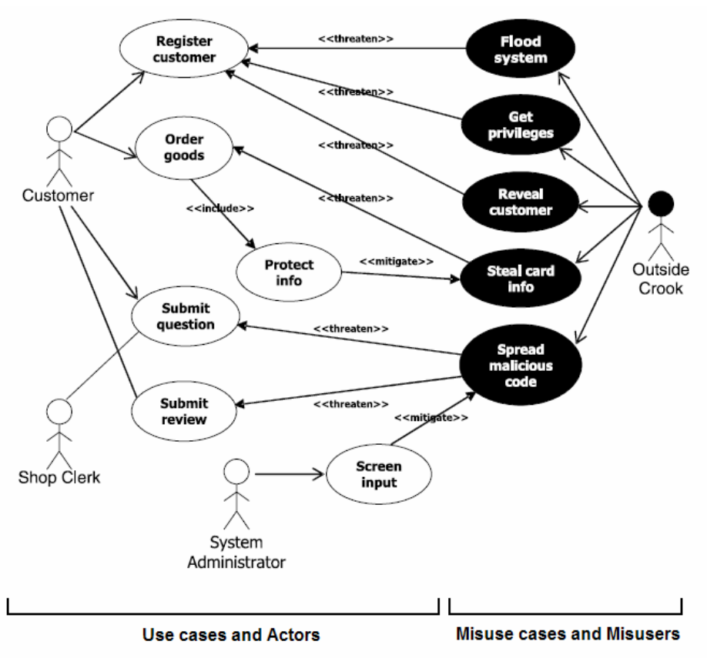
Misuse case
A misuse case is the evil twin of a use case.
“special kind of use case, describing behavior that the system/entity owner does not want to occur” (Sindre & Opdahl, 2000).
A misuser is a bad actor.
“an actor that initiates misuse cases, either intentionally or inadvertently” (Alexander, 2002)
Misuse cases and use cases shown together.
The association between a misuse case and a use case can either be a “threatens” or a “mitigates” relationship
https://www.cs.auckland.ac.nz/courses/compsci725s2c/archive/termpapers/csia.pdf
Notes:
Use cases tend to focus more on what a system does rather then how the system does it. As such, they are not good at showing the opposite; that is, what a system should not do.
https://www.cs.auckland.ac.nz/courses/compsci725s2c/archive/termpapers/csia.pdf
Sindre G, Opdahl AL (2000) Eliciting security requirements by misuse cases. In: Proceedings of TOOLS Pacific 2000, Sydney, Australia
Alexander IF (2002) Initial industrial experience of misuse cases in trade-off analysis. In: Proceedings of the 10th anniversary IEEE international requirements engineering conference (RE’02), Essen, Germany
Sindre took the view that it may be interesting to look at the use and misuse together, hence they illustrate use cases and misuse cases in the same diagram. To avoid confusion between the two, misuse cases and any mis-actors are shown in an “inverted” format.
A misuser (which replaces mis-actor) is “an actor that initiates misuse cases, either intentionally or inadvertently”. The association between a misuse case and a use case can either be a “threatens” or a “mitigates” relationship [8]. A use case can mitigate a misuse case. This means that the use case reduces the chance of a misuse case succeeding.

Slide 11
Misuse cases - features
1. Requires experienced security people to come up with relevant threats.
1. 需要有经验的安全人员提出相关的威胁。
2. Greater consistency of results because more detailed system model.
由于系统模型更详细，结果的一致性更强。
3. Diagram and natural language description easy to understand and communicate with customers and users.
3。图表和自然语言描述，易于理解和与客户和用户沟通。
4. Helps identify mitigations.
帮助确认mitigation来减少vulnerable对抗threat
5. Hard to assess relative risk of threats.
很难评估威胁的相对风险。
6. Focus on use cases makes it easier to know when to stop in terms of considering whether considered at least one threat per function.
在考虑是否每个功能至少考虑一个威胁时，关注用例可以更容易地知道何时停止
改进的技术:角色+用例——将攻击者合并到模型中。
Improved technique: personas + use cases – incorporate the attacker into the model.

Slide 12
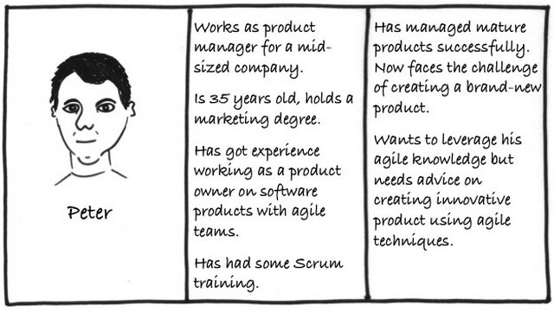
Personas人物角色；角色模型
Developing systems is hard if you don’t know for whom you are developing.
Personas are fictional characters, which you create based upon your research in order to represent the different user types that might use your service, product, site, or brand in a similar way. Creating personas will help you to understand your users’ needs, experiences, behaviours and goals.
https://www.interaction-design.org/literature/article/personas-why-and-how-you-should-use-them
Notes:
Personas are fictional characters, which you create based upon your research in order to represent the different user types that might use your service, product, site, or brand in a similar way. Creating personas will help you to understand your users’ needs, experiences, behaviours and goals.
https://www.interaction-design.org/literature/article/personas-why-and-how-you-should-use-them

Slide 13
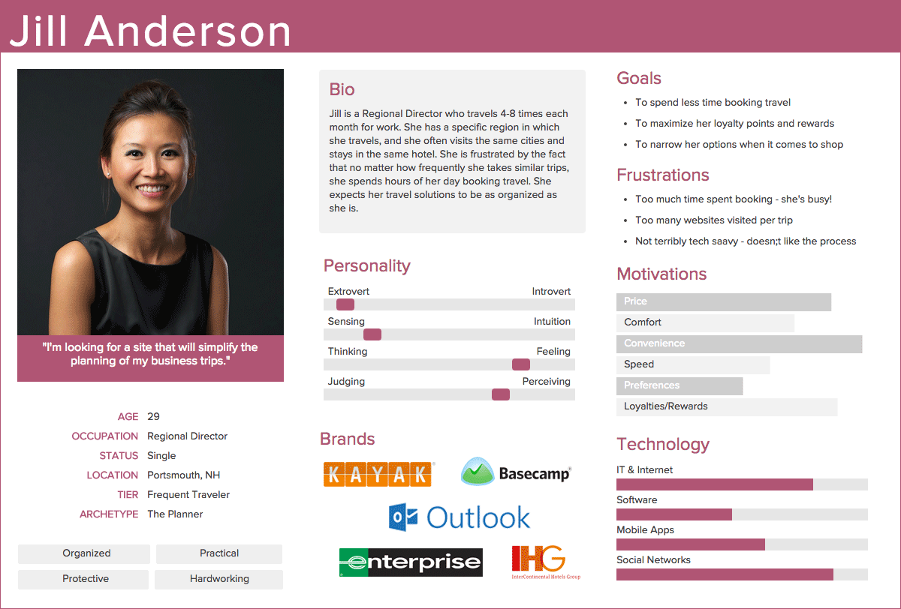
Personas – typical example
No single format but some common features.
Fictional biography:
user’s education, lifestyle, interests, values, goals, needs, limitations, desires, attitudes, and patterns of behaviour.
a few fictional personal details to make the persona a realistic character.
Persona needs a name and a photo to personalise them.
Persona isn’t an ideal person, they can be flawed like real people.
Create 1–2-pages of descriptions for each persona.
A rule of thumb is that a project will typically have 5-8 personas.
https://xtensio.com/user-persona/
Notes:
The method of developing personas stems from IT system development during the late 1990s where researchers had begun reflecting on how you could best communicate an understanding of the users. Various concepts emerged, such as user archetypes, user models, lifestyle snapshots, and model users. In 1999, Alan Cooper published his successful book, The Inmates are Running the Asylum, where he, as the first person ever, described personas as a method we can use to describe fictitious users. There are a vast number of articles and books about personas, however a unified understanding of one single way to apply the method doesn’t exist, nor does a definition of what a persona description should contain exactly.
You don't "make up" personas, but instead discover them as a byproduct of your requirements investigation process.
Write specific personas: you will have a much greater degree of success designing for a single person. The "generic user" will bend and stretch to meet the moment, but your true goal should be to develop software which bends and stretches. Your personas should "wiggle" under the pressure of development.
http://www.agilemodeling.com/artifacts/personas.htm
The 5-8 comes from a paper by Nancy Lynch
https://www.researchgate.net/publication/320027543_Crowd_Sourcing_the_Creation_of_Personae_Non_Gratae_for_Requirements-Phase_Threat_Modeling

Slide 14
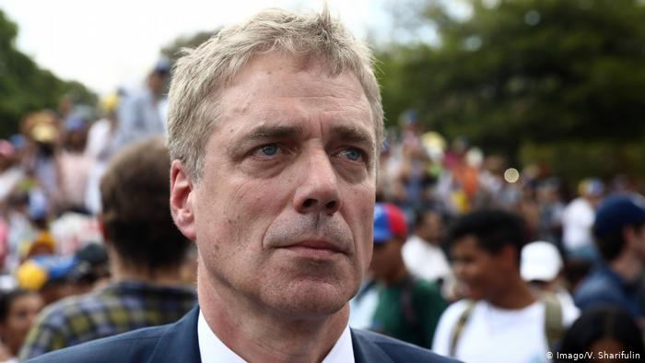
Persona non gratae
Latin for “an unwelcome person”
Article 9 of the 1961 Vienna Convention for Diplomatic Relations.
A country can declare a member of a diplomatic staff persona non grata “at any time and without having to explain its decision”.
Must leave and never re-enter.
Applied to security to help people develop misuse cases.
Examples: German ambassador to Venezuela (2019)
https://www.dw.com/cda/en/what-does-it-mean-to-be-declared-persona-non-grata/a-47800884
Notes:
https://www.dw.com/cda/en/what-does-it-mean-to-be-declared-persona-non-grata/a-47800884
In literal terms, the phrase is Latin for "an unwelcome person." The term in a diplomatic sense refers to a foreign person whose entering or remaining in a certain country is prohibited by that country.
The designation received diplomatic meaning at the 1961 Vienna Convention for Diplomatic Relations. Under Article 9 of the treaty, a country can declare any member of a diplomatic staff persona non grata "at any time and without having to explain its decision."
The persona non grata declaration is the most damning form of censure a country can bestow on foreign diplomats considering they are protected from arrests and other forms of prosecution under diplomatic immunity.
The Persona non Grata method provided an overview of just who might be interested in stealing the database files, what they might want to do with those files, and the potential sophistication levels of the threat actors. These profiles help build an understanding of the primary threats to the organization and the tools those threats may employ to stage a potential attack.

Slide 15
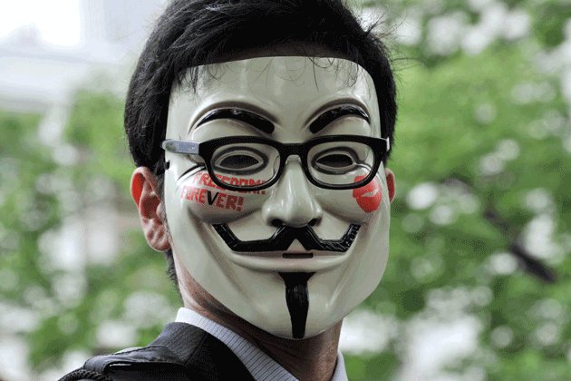
Persona non grata (PnG)
J. Cleland-Huang. How Well Do You Know Your Personae Non Gratae? IEEE Software, 31(4):28–31, July 2014.
Focus on atypical users who are act in unwanted, possibly nefarious ways.
Background gives us their motivations and abilities.
Goals that they want to achieve.
Help us develop misuse cases that may achieve these goals using their abilities.
http://www.propublica.org/images/ngen/gypsy_big_image/gt-anonymous-hacker-mask-147972008-630.png
Notes:
J. Cleland-Huang. How Well Do You Know Your Personae Non Gratae? IEEE Software, 31(4):28–31, July 2014
The Persona non Grata method provided an overview of just who might be interested in stealing the database files, what they might want to do with those files, and the potential sophistication levels of the threat actors. These profiles help build an understanding of the primary threats to the organization and the tools those threats may employ to stage a potential attack.
PnGs represent archetypal users who behave in unwanted, possibly nefarious ways. However, like ordinary personas, PnGs have speciﬁc goals that they wish to achieve, and speciﬁc actions that they may take to achieve their goals. Modeling PnGs can therefore help us to think
about the ways in which a system might be vulnerable to abuse and use this information to specify appropriate mitigating requirements.
The PnG approach makes threat modeling more tractable by asking users to focus on attackers, their motivations, and abilities. Once this step is completed, users are asked to brainstorm ideas about targets and likely attack mechanisms that the attackers would deploy.
The theory behind this approach is that if engineers can understand what capabilities an attacker may have, and what types of mechanisms they may use to compromise a system, the engineers will gain a better understanding of targets or weaknesses within their own systems and the
degree to which they can be compromised. Some critics of this approach argue that a PnG can often take users down the wrong path. For example, for a system related to national security, users might reason that the system may be the target of a sophisticated attack from another nation
state. This conclusion, however, overlooks the fact that a nation state might compromise a system ﬁrst through a much simpler entry point and then ratchet up operations from there.

Slide 16
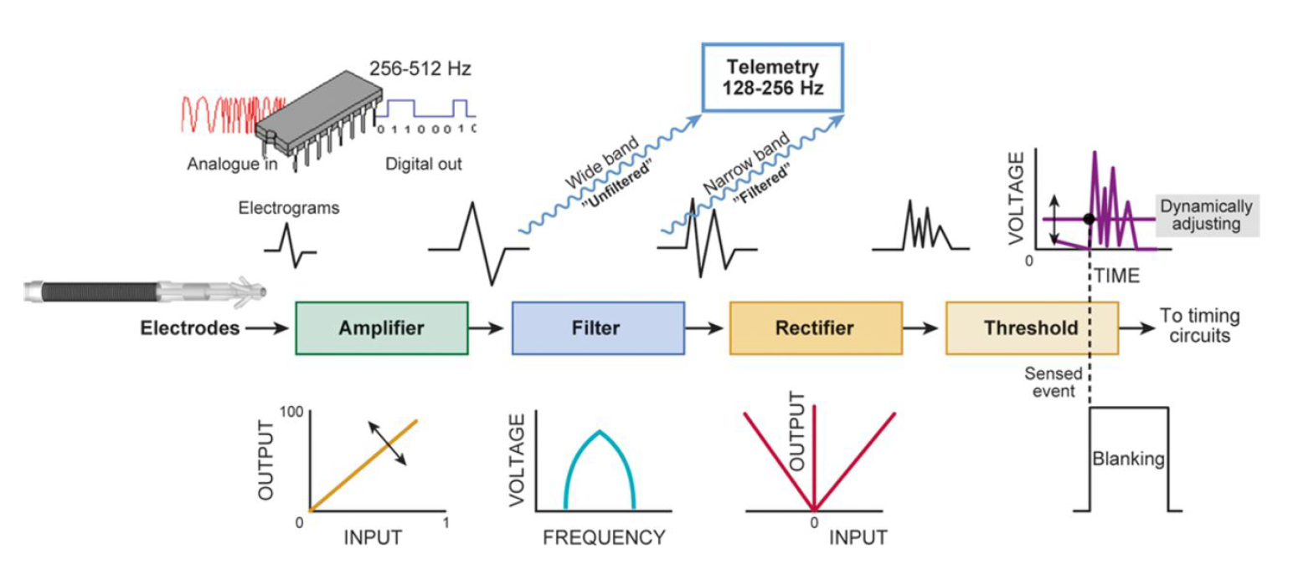
Persona non grata – Example (ICDs)
Implantable cardioverter-defibrillators (ICDs)
A Hybrid Threat Modeling Method Nancy R. Mead Forrest Shull Krishnamurthy Vemuru, University of Virginia Ole Villadsen, Carnegie Mellon University March 2018 TECHNICAL NOTE CMU/SEI-2018-TN-002
https://resources.sei.cmu.edu/asset_files/TechnicalNote/2018_004_001_516627.pdf
Notes:
Let’s look at an example. From a study led by Nancy Lynch from CMU.
Implantable cardioverter-defibrillators (ICDs)
A Hybrid Threat Modeling Method Nancy R. Mead Forrest Shull Krishnamurthy Vemuru, University of Virginia Ole Villadsen, Carnegie Mellon University March 2018 TECHNICAL NOTE CMU/SEI-2018-TN-002
https://resources.sei.cmu.edu/asset_files/TechnicalNote/2018_004_001_516627.pdf

Slide 17
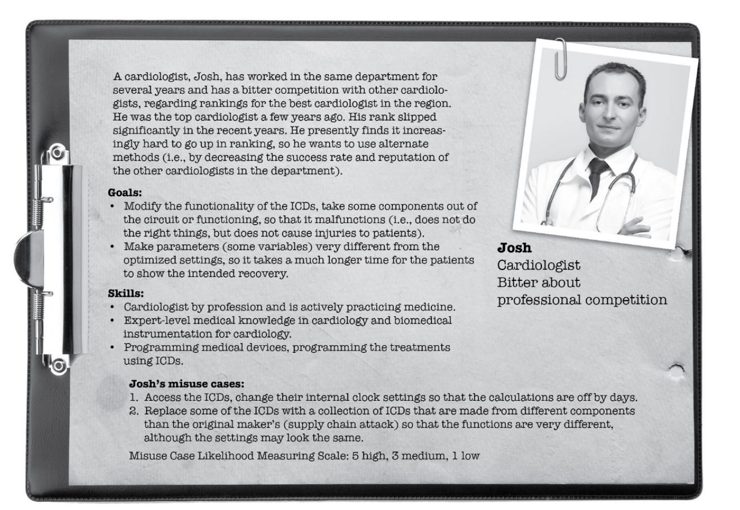
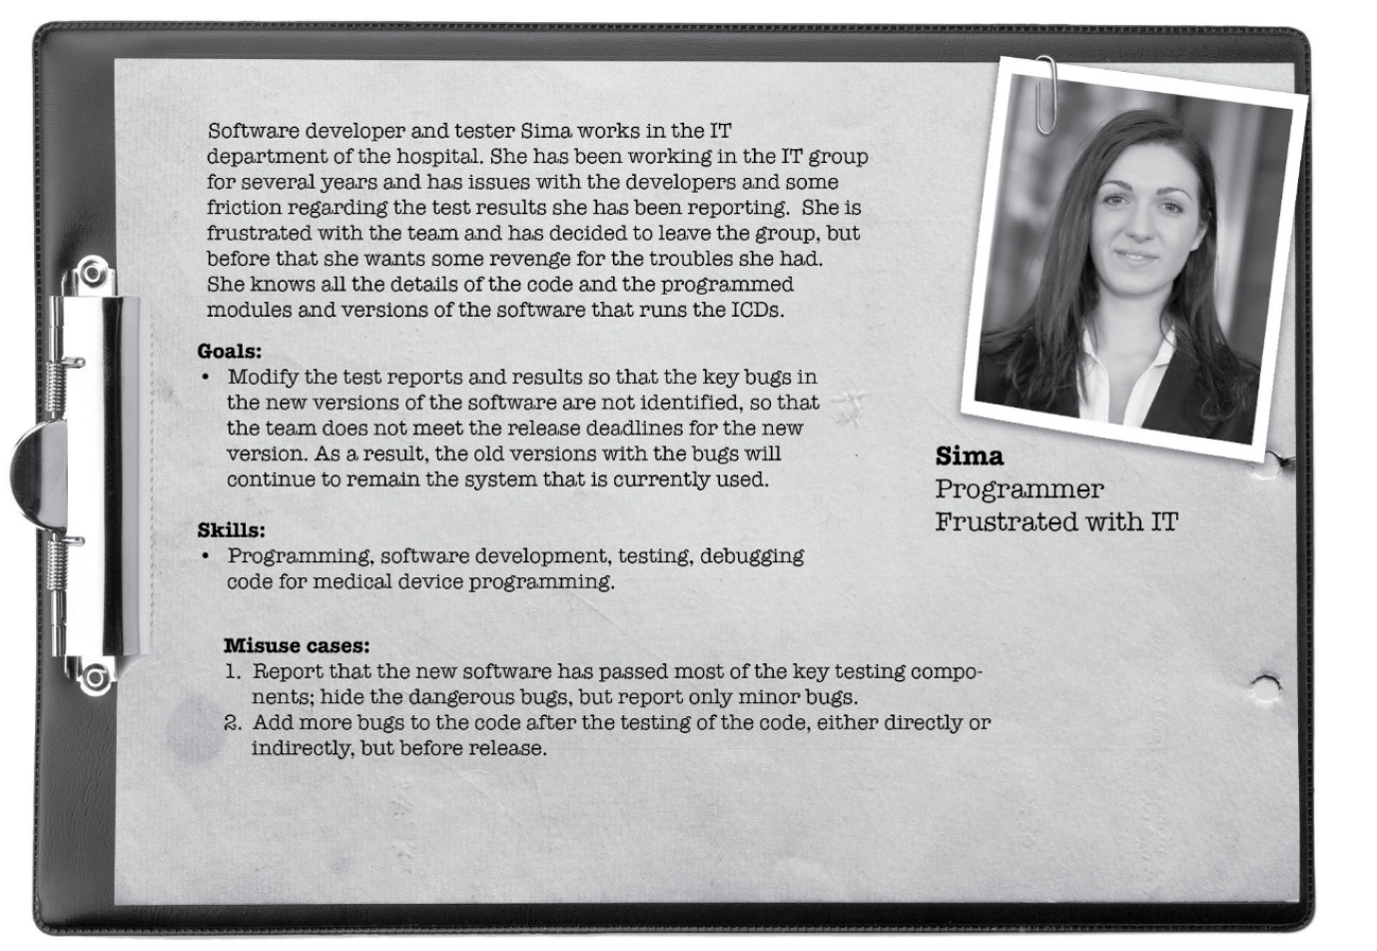
Persona non grata – personas
Notes:
PnGs represent archetypal users who behave in unwanted, possibly nefarious ways. However, like ordinary personas, PnGs have specific goals that they wish to achieve and specific actions that they may take to achieve their goals. Modeling PnGs can therefore help us to think about the ways in which a system might be vulnerable to abuse and use this information to specify appropriate mitigating requirements.
The PnG approach makes threat modeling more tractable by asking users to focus on attackers, their motivations, and abilities. Once this step is completed, users are asked to brainstorm ideas about targets and likely attack mechanisms that the attackers would deploy. The theory behind this approach is that if engineers can understand what capabilities an attacker may have and what types of mechanisms they may use to compromise a system, the engineers will gain a better un-derstanding of targets or weaknesses within their own systems and the degree to which they can be compromised. Some critics of this approach argue that a PnG can often take users down the wrong path. For example, for a system related to national security, users might reason that the sys-tem may be the target of a sophisticated attack from another nation-state. This conclusion, how-ever, overlooks the fact that a nation-state might compromise a system first through a much sim-pler entry point and then ratchet up operations from there.
We provide examples of two PnGs in Figure 3. These PnGs were constructed manually for train-ing purposes and target the domain of Electro-Cardio Converters. Each PnG includes an image of the persona, his or her name, a description, the assumed role (e.g., Mechanical Engineer), and a moniker (e.g., Bitter and revengeful). Furthermore, it includes a set of relevant goals and skills, and a set of misuse cases that describe specific ways in which the PnG intends to attack the sys-tem [Opdahl 2009]. From this, we can construct a threat model that includes the actor (i.e., the PnG) and the attack mechanism and target specified in the misuse cases. Attack intent is provided in the general description.

Slide 18
Persona non grata – add misuse cases
Brainstorming + looking at system model = misuse cases

Slide 19
PnG - features不受欢迎的人的特征
1. Process involves wider ordinary developers as well as experienced security experts.
2. Tends to have more focused and consistent results when repeated.
3. Persona description, diagram and natural language description easy to understand and communicate with customers and users.
4. Helps identify mitigations.
5. Easier to assess relative risk of threats based upon attacker motivations and abilities
Improved technique: security cards to give prompts and allow less experienced security people or non-security people to become involved in the threat modeling process.
1.过程涉及更广泛的普通开发人员以及经验丰富的安全专家。
2.重复时倾向于获得更集中和一致的结果。
3.角色描述，图表和自然语言描述易于理解并与客户和用户沟通。
4.帮助确定缓解措施。
5.更容易根据攻击者的动机和能力来评估威胁的相对风险
改进的技术：安全卡发出提示，并允许经验不足的安全人员或非安全人员参与威胁建模过程。

Slide 20
Security cards
Emphasis of creativity and brainstorming.
Useful for fundamental learning to aiding professional threat modelers.
Answer four main questions:
If your system were compromised what human assets could be impacted?
Who might attack your system and why?
What resources might the adversary have?
How might the adversary attack your system?
AMARA DENNING, BATYA FRIEDMAN, AND TADAYOSHI KOHNO (2013)
https://securitycards.cs.washington.edu/
强调创造力和头脑风暴。
有用的基本学习，以帮助专业的威胁建模者
回答四个主要问题:
-如果你的系统受到影响，哪些human assets会受到影响?
-谁可能攻击您的系统，为什么?
对手可能有什么资源?
对手会如何攻击你的系统?
Notes:
Security Cards is an approach to threat modeling that emphasizes creativity and brainstorming over more structured approaches, such as checklists, to help users identify unusual or more so-phisticated attacks. The method is suitable for purposes ranging from fundamental learning about security threats to aiding advanced professionals in system design [Denning 2013]. The use of Se-curity Cards helps to answer the following questions: If your system were compromised, what human assets could be impacted? Who might attack your system and why? What resources might the adversary have? How might the adversary attack your system?

Slide 21
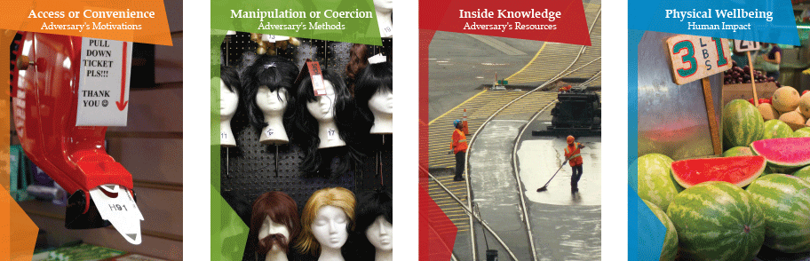
Security cards
Notes:
In a Security Card deck, the 42 cards are divided into four dimensions: Human Impact (9), Adver-sary’s Motivations (13), Adversary’s Resources (11), and Adversary’s Methods (9). The Human Impact cards focus on the different ways an attack can affect human lives, such as financial loss and violations of privacy. Adversary’s Motivations cards uncover the reasons why someone would desire to carry out an attack on an information system, such as financial gain or revenge. The ways and means for carrying out such an attack, such as tools or expertise, are addressed in the Adversary’s Resources cards. Finally, Adversary’s Methods cards investigate how an attacker might carry out an attack, such as through technical means or through coercion or manipulation. A card example looks like this:

Slide 22
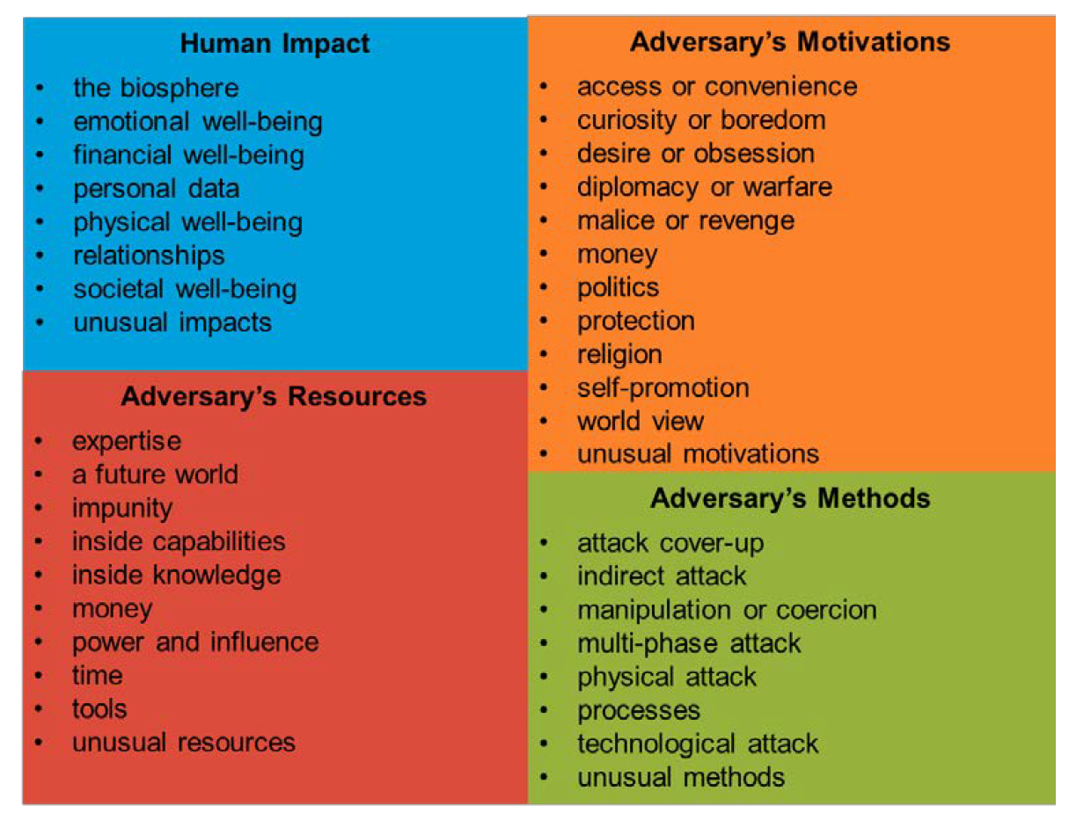
Security cards
Human Impact
the biosphere
emotional well-being
financial well-being personal data
physical well-being relationships
societal well-being
unusual impacts
Notes:
Users can apply Security Cards for threat modeling in many ways, according to the Security Card designers [Denning 2013]. For example, threat modelers could begin with a system or application.
They wish to protect and investigate each dimension individually to determine the extent to which each card might affect the system. Alternatively, they could also explore and assemble combina-tions of cards from different dimensions to uncover the most relevant and critical cyber threats.

Slide 23
Security cards - process
Start with a description of a system.
Break into groups.
Look at the cards.
Sort the cards within each dimension in order of relevance to the system being analysed.
Document results.
从系统描述开始。
分成小组。
看卡片。
按与要分析的系统相关的顺序对每个维度内的卡进行排序。
记录结果。

Slide 24
Security cards - features
1. Encourages collaboration with wide range of stakeholders.
2. Inconsistent results and identification of threats that don’t apply to this particular system.
3. Targets out of the ordinary threats leading to greater coverage of possible threats to a system.
Summary: can be a useful “add-on” to other techniques or used for training purposes.
Note – other games exists such as Privilege Escalation Game
1.鼓励与广泛的利益相关者合作。
2.结果不一致，并且无法识别适用于该特定系统的威胁。
3.非常规威胁的目标导致对系统可能威胁的更大范围的覆盖。
简介：可以作为其他技术的有用“附加”或用于培训目的。
注–存在其他游戏，例如特权升级游戏

Slide 25
Security cards - features
1. Requires experienced security people to come up with relevant threats.
2. Tends to have consistent results when repeated.
3. Persona description, diagram and natural language description easy to understand and communicate with customers and users.
4. Easier to assess relative risk of threats based upon attacker motivations and abilities
5. Tends to detect only some subsets of threats (might focus on ordinary threats).
Improved technique: security cards to encourage people to think more widely
CMU SEI Hybrid technique uses both security cards and PnG to generate more consistent results while allowing wider participation and less chance of missing threats.

